Slide 1

NBA: Predicting Player Salary and Position
Arsh Modak – Omkar Waghmare
Jay Majithia – Sahar Shady

Slide 2


THE FLOW
Data Collection
Data Pre-processing
EDA
Machine Learning
Model Evaluation

Slide 3

Data Collection and Explanation
We scraped our data from the official NBA website (Player Stats, Advance Stats and Team Stats) and Hoops Hype (Salary and Inflated Salary)
Our data consists of 13,416 observations and 76 variables.
Our response variables are Salary and Position.

Slide 4

Cleaning and Pre-Processing
To make our data ready for EDA and Machine Learning, we did the following:
Joined the five scraped datasets
Corrected data types of all variables
Removed “$” and “,” from Salary and Inflated Salary
Imputed missing values using missForest (double checked if data is correctly imputing by comparing medians)
Removed variables with near zero variance
Removed variables with low correlation
Standardized our data for USML

Slide 5

EXPLORATORY DATA ANALYSIS

Slide 6
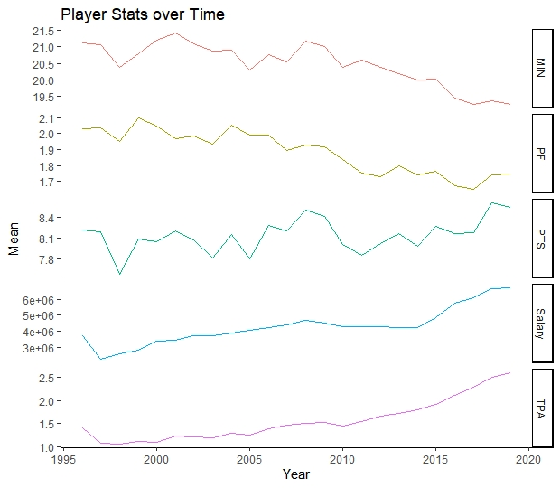
From the graph we can conclude that the players have become more efficient over the years.
This is depicted in the increase in Points Scored and Three Pointers and decrease in Minutes Played over time.
The rate of Personal Fouls have also decreased.
The Salary of the players also sees an increasing trend. Two factors play an important role here: Inflation and better performance of players. (Better players are paid more)

Slide 7
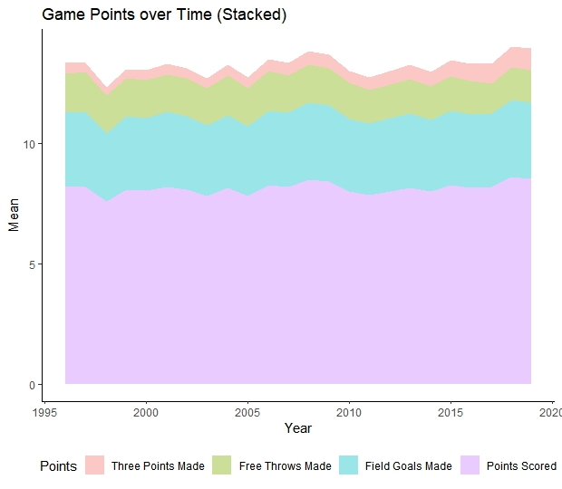
As depicted by the graph, we can see the contribution of different types of points in overall Points.
Field Goals Made contribute the most towards Total Points Scored.
Next are Free Throws
Three Pointers contribute the least.

Slide 8
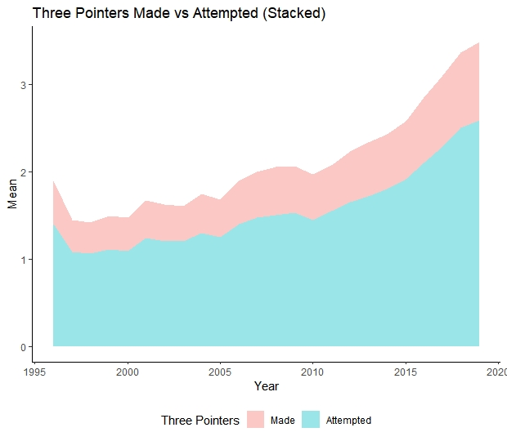
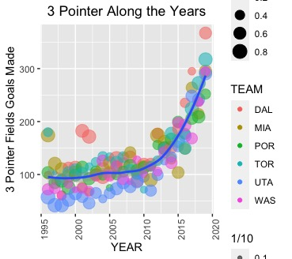

Slide 9

EDA with respect to SALARY (Fitting a Linear Model)

Slide 10
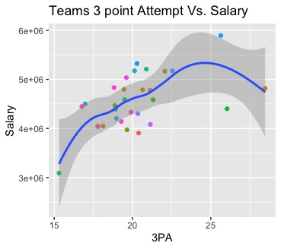
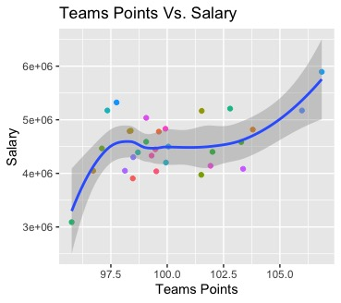
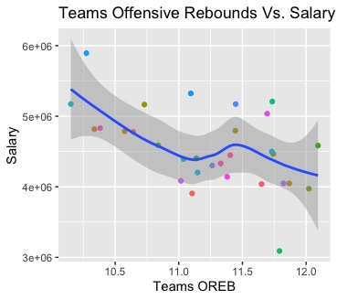

Slide 11
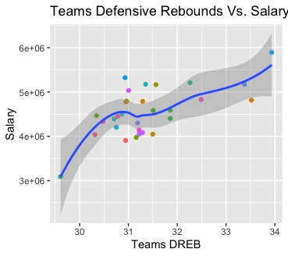
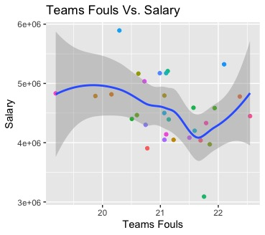
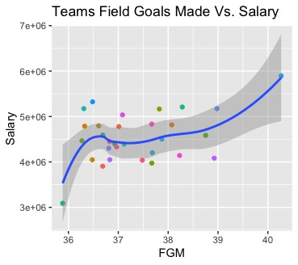

Slide 12
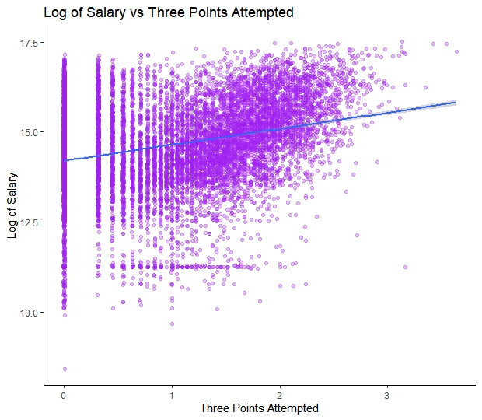
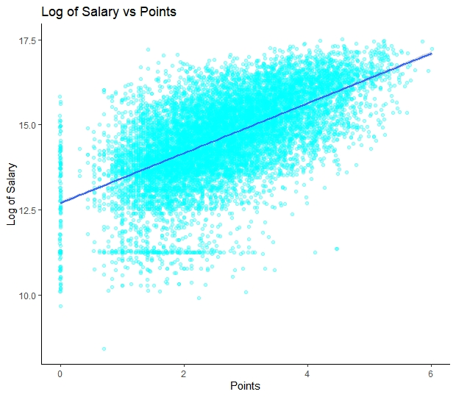
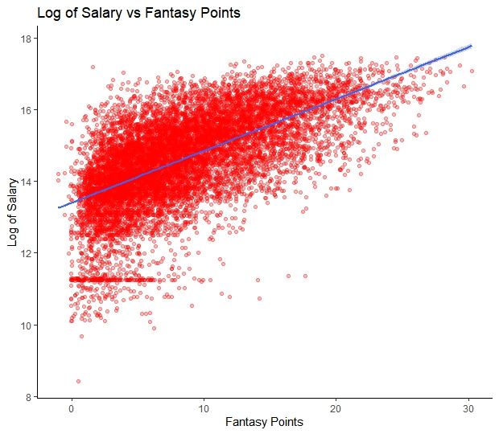
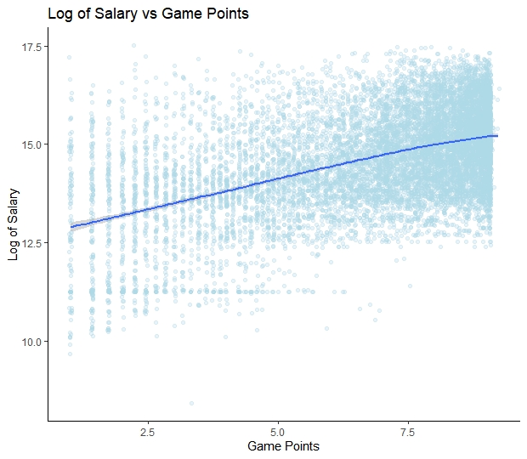
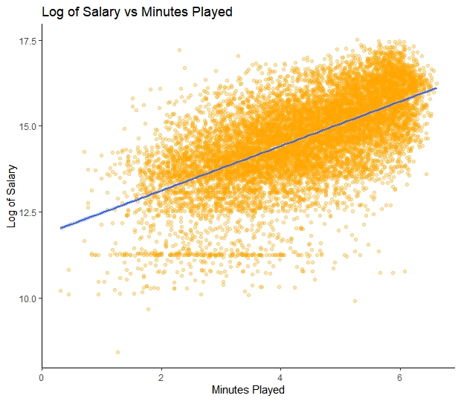
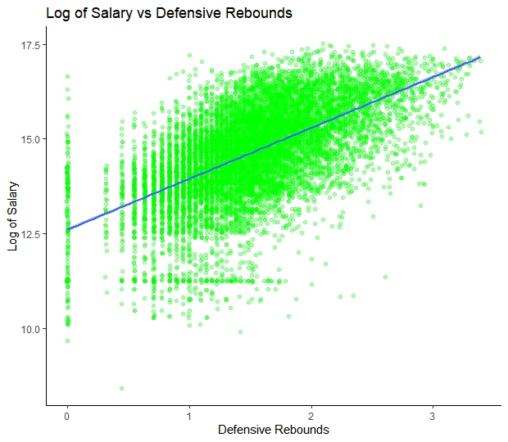

Slide 13

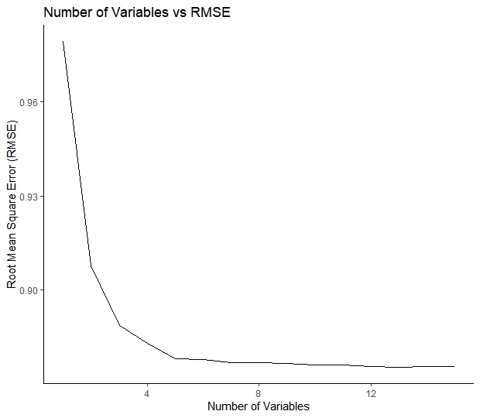
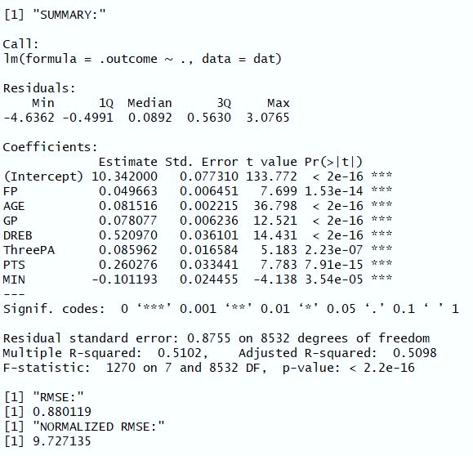
Summary of The Linear Regression and Stepwise RMSE Plot

Slide 14
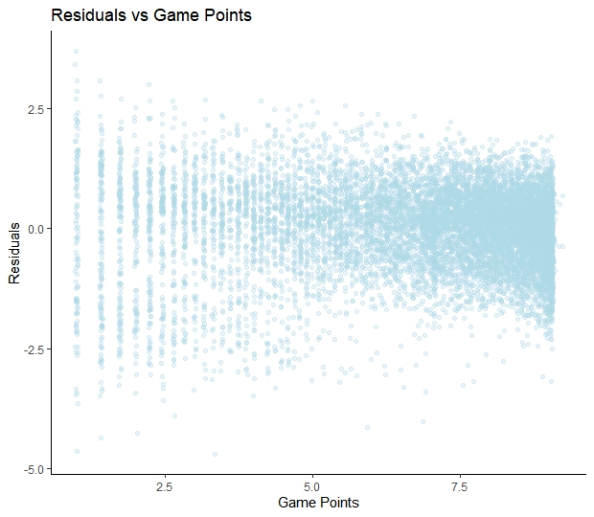
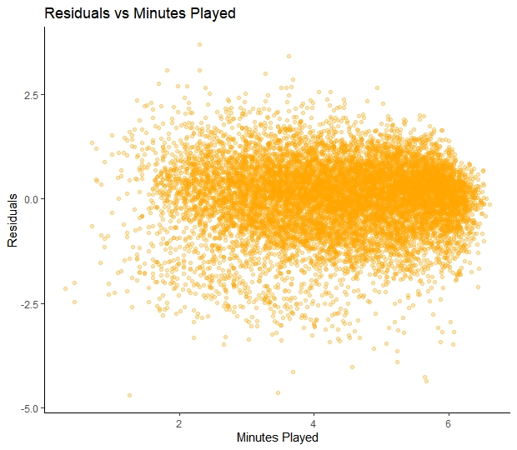
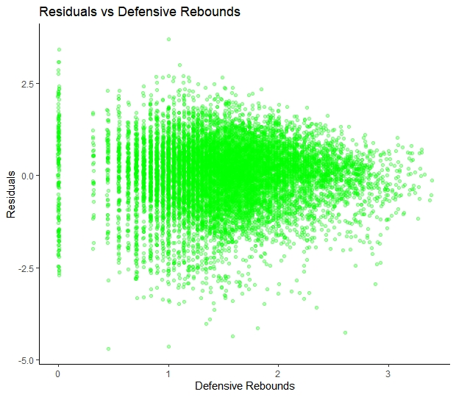
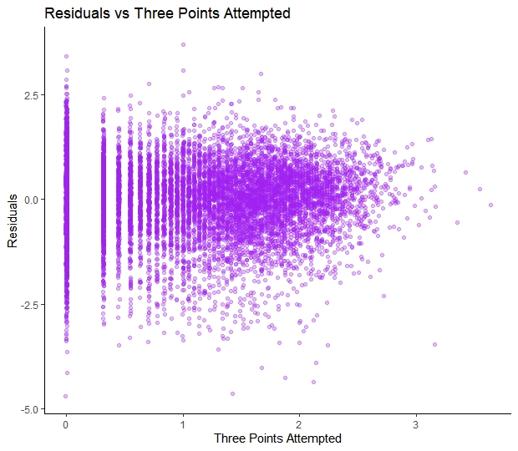
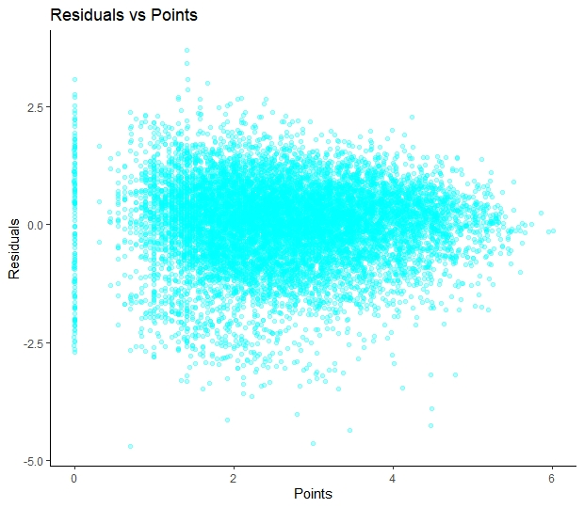
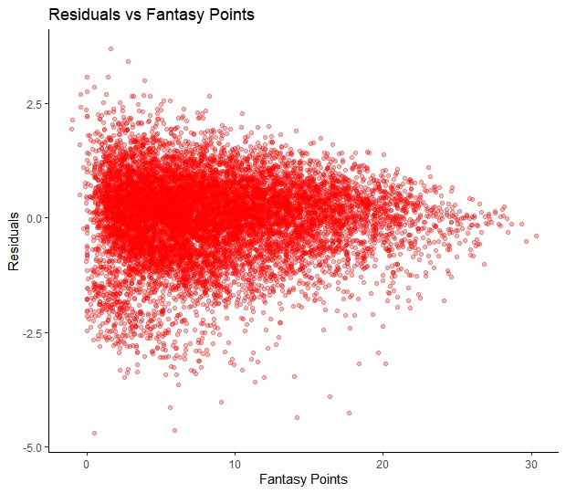

Slide 15
EDA and ML with respect to Position
Position
Center
Forward
Guard

Slide 16
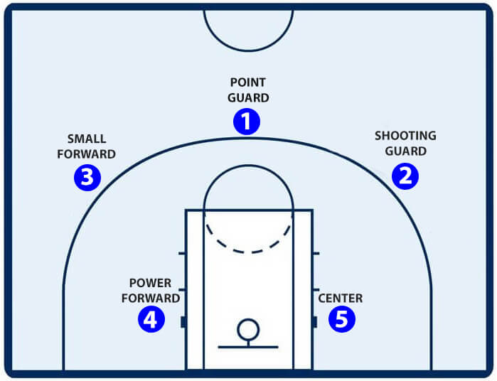

Slide 17
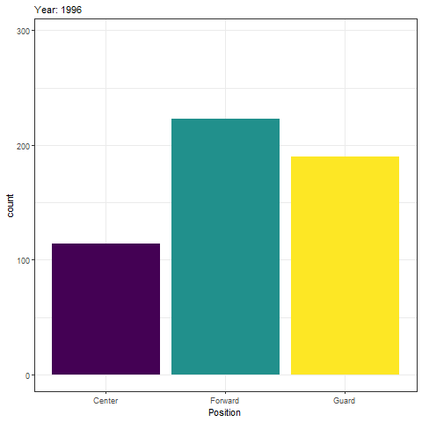

Slide 18
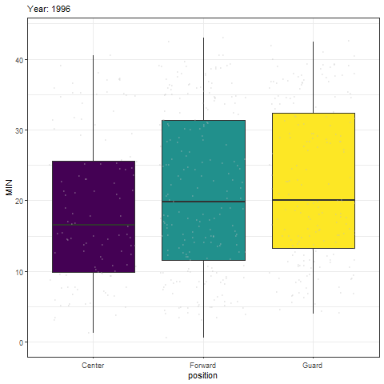
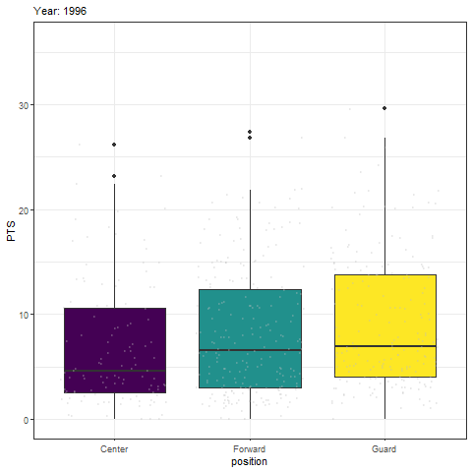

Slide 19
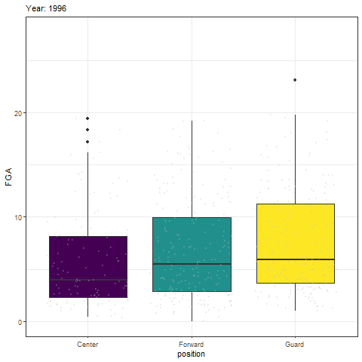
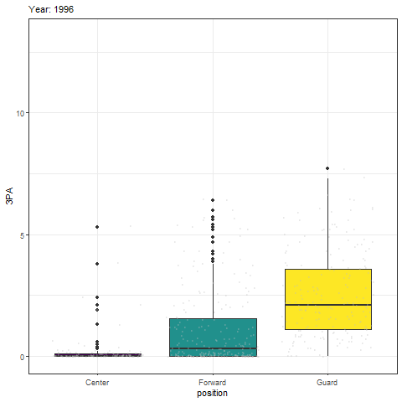
fff

Slide 20
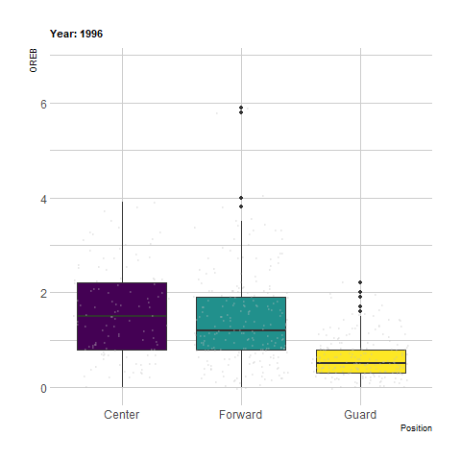
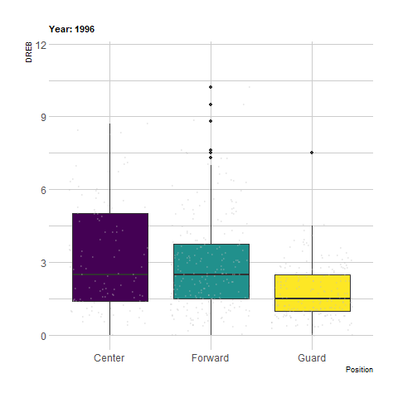
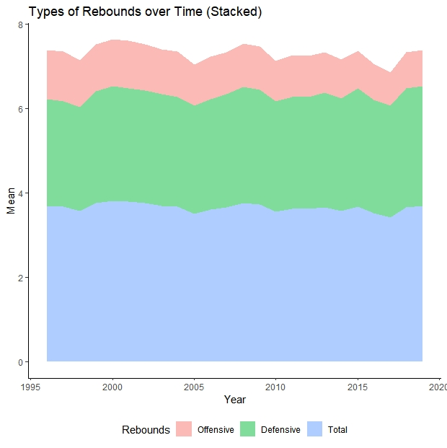

Slide 21
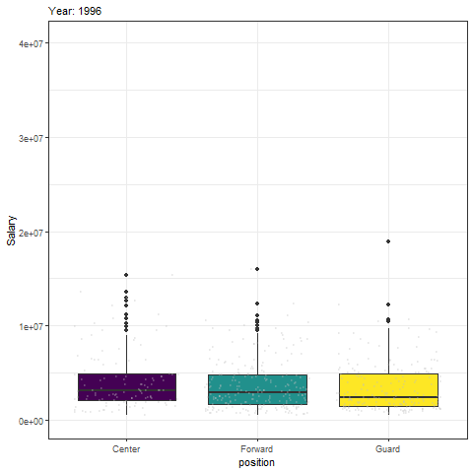
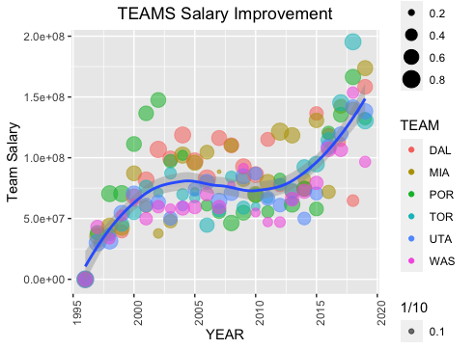

Slide 22
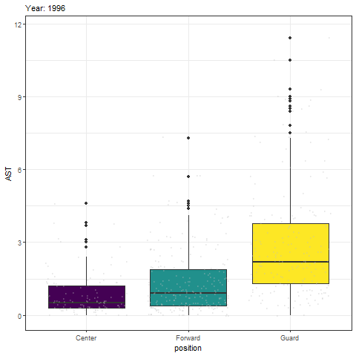
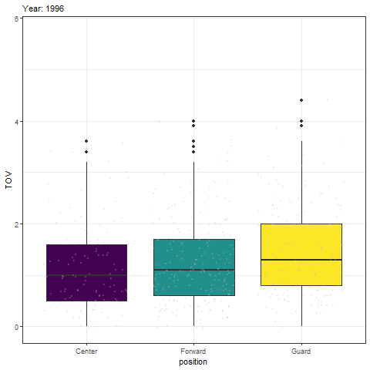

Slide 23

PREDICTING POSITIONS USING UNSUPERVISED MACHINE LEARNING

Slide 24
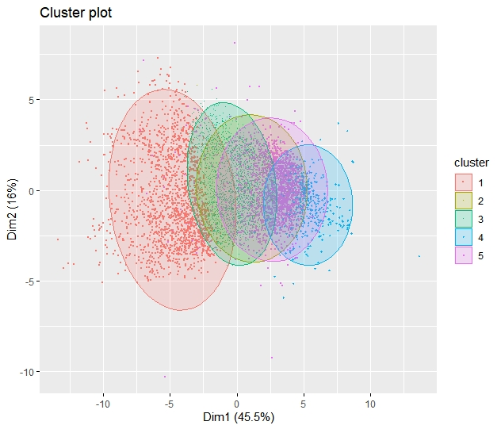
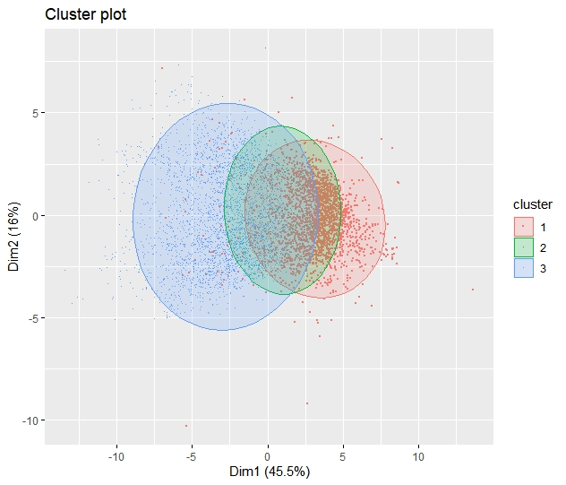
THREE VS FIVE CLUSTERS FOR POSITION (K-Means Clustering)

Slide 25

PREDICTING POSITIONS USING SUPERVISED MACHINE LEARNING

Slide 26
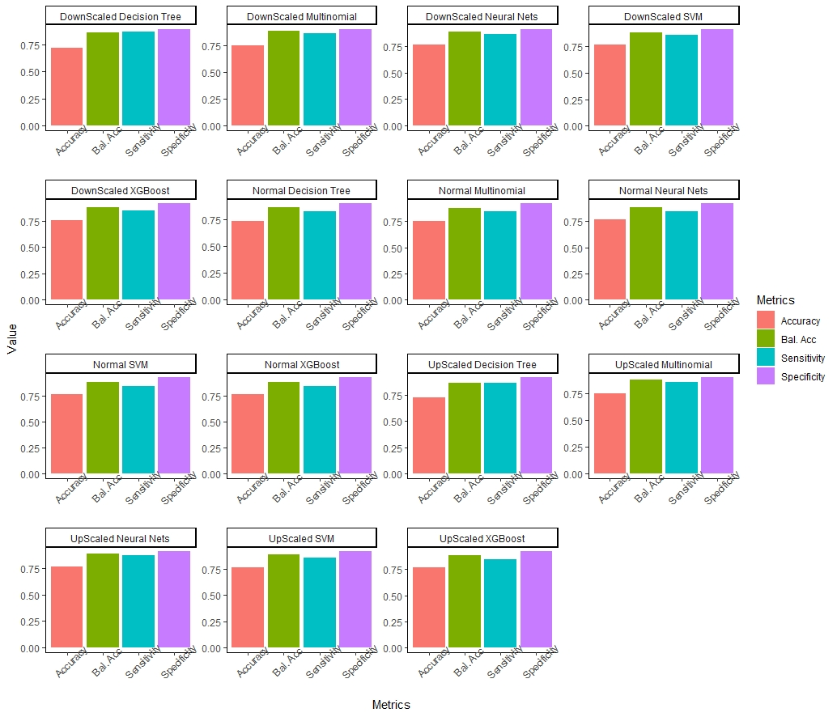

Slide 28
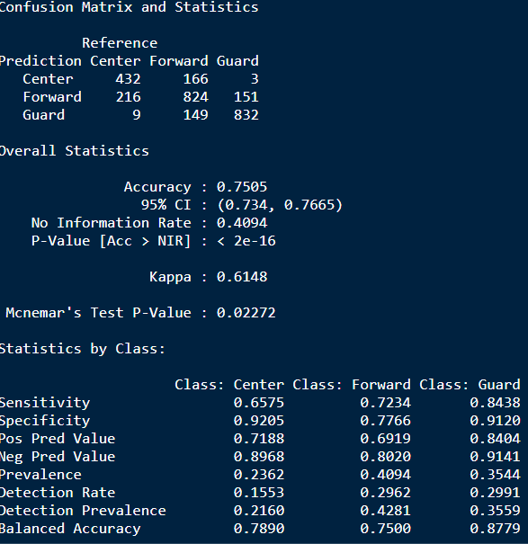
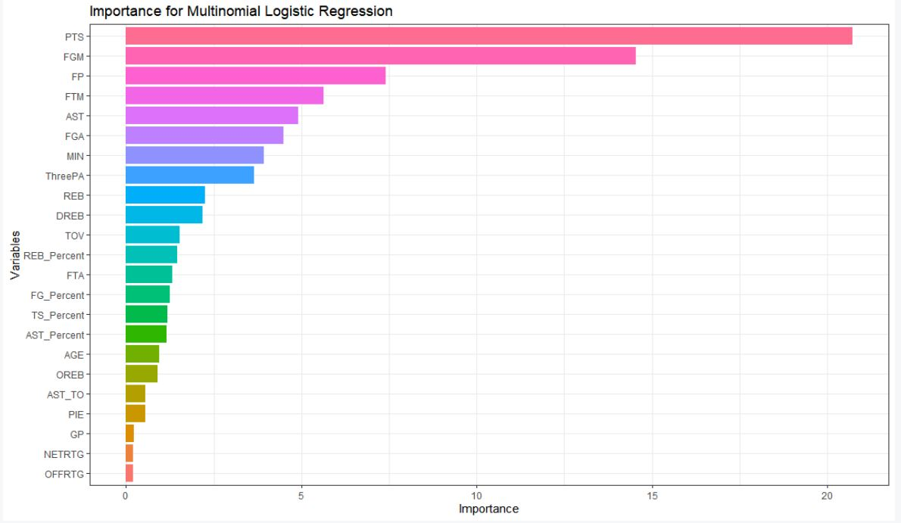
Multinomial Logistic Regression

Slide 29
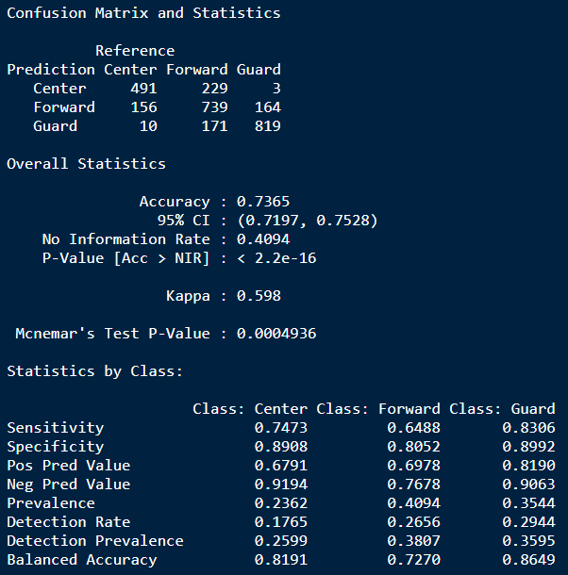
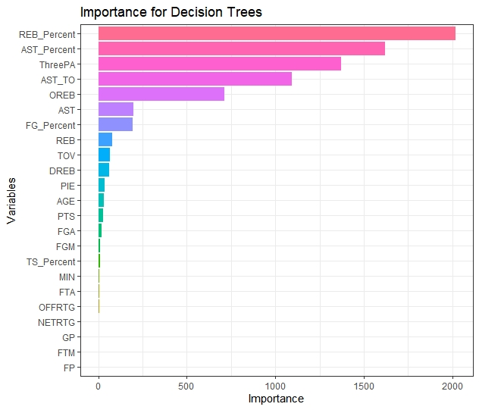
Decision Tree

Slide 30
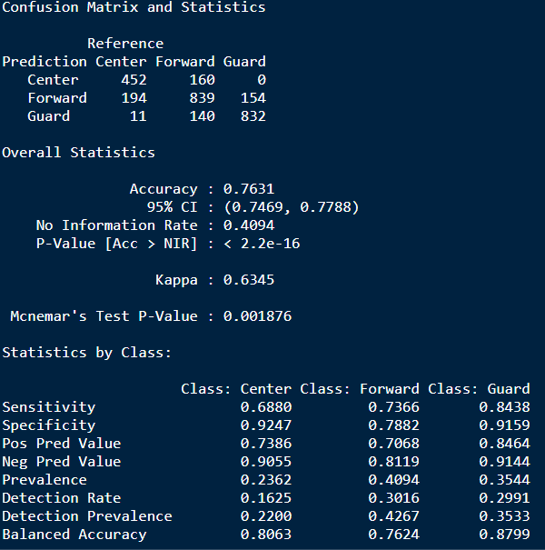
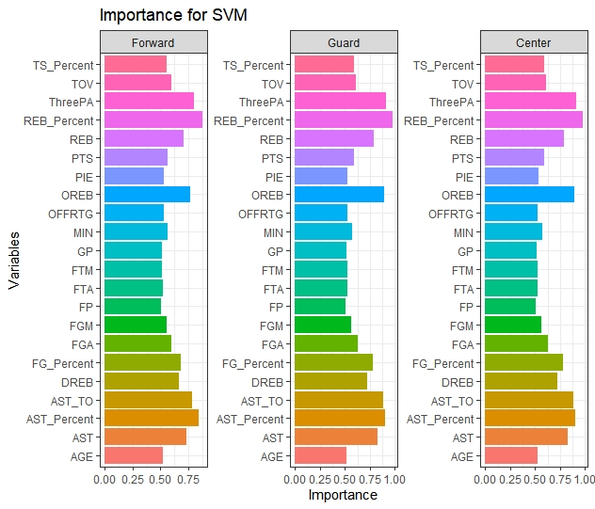
Support Vector Machines

Slide 31
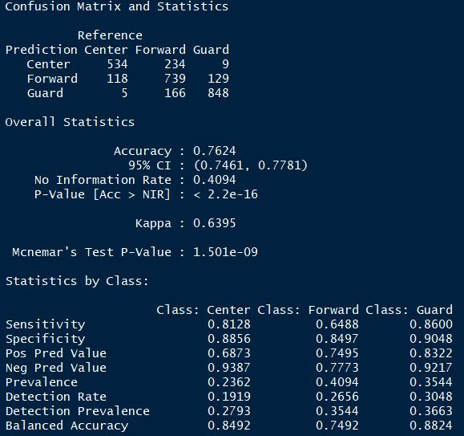
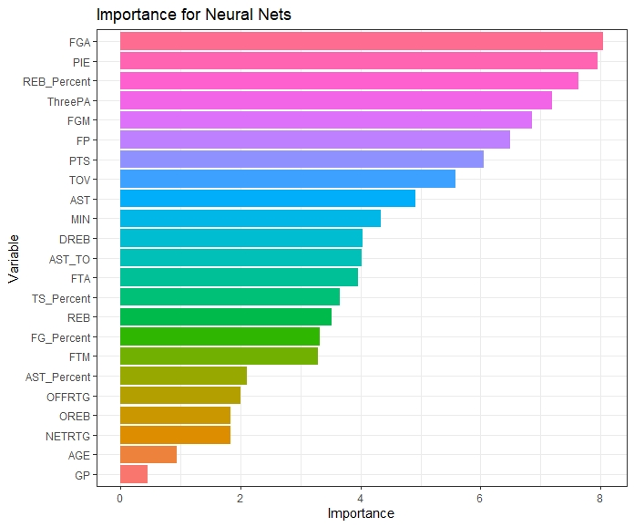
Neural Networks

Slide 32
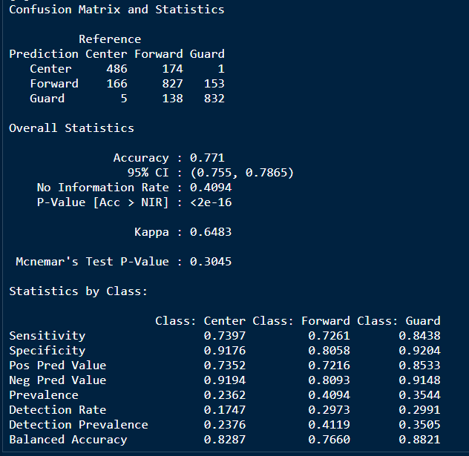
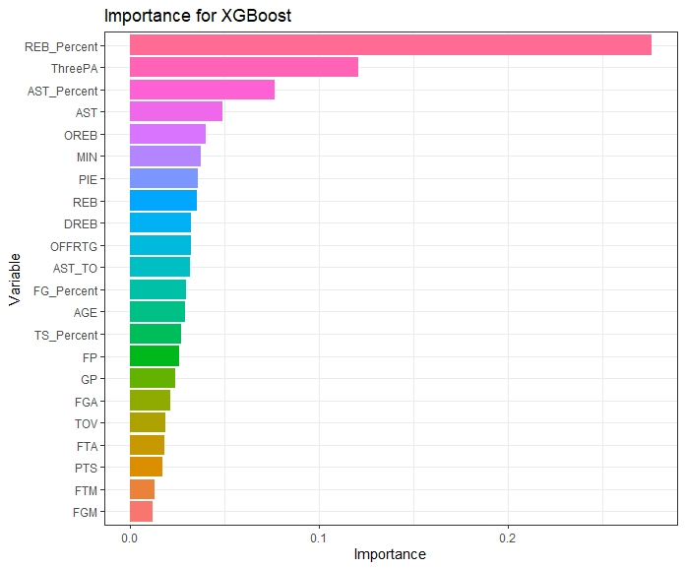
Extreme Gradient Boosting

Slide 33

REFERENCES
https://www.nba.com/
https://stats.nba.com/help/glossary/
https://www.basketball-reference.com/
https://hoopshype.com/salaries/

Slide 34

Thanks
ANY

